Slide 1
Morphing
Students:
Katarina Lebo
Antun Herkov
Ivan Jakas
Branimir Beš
Damjan Grubelić

Slide 2
ABOUT MOrphing
Step by step image transformation
metamorphosis from one image to another
First mentioned in 16. century

Slide 3
Morphing in practice
MOVIE INDUSTRY
Computer-generated imagery (CGI)
VIRTUAL REALITY
Real-time morphing
MEDICINE
Wound healing process
ARCHAEOLOGY
Atrifact reconstruction and modeling

Slide 4
IMPLEMENTED SOLUTIONS
LINEAR MORPHING
ADVANCED
One image fades into another
Entire images are used
Pixels from the first image transform into the pixels from the second image
SM = (1 − α)SI − α · SC
α = 0 results in no changes
More complex
Uses landmarks
Delaunay triangulation

Slide 5
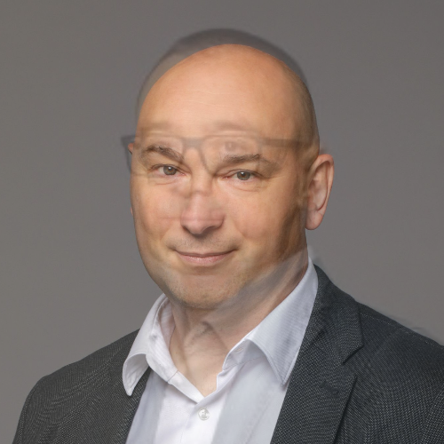
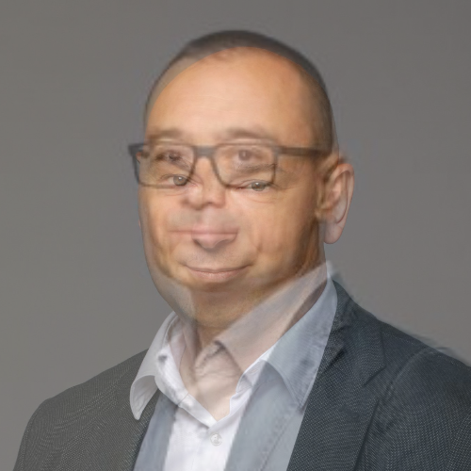
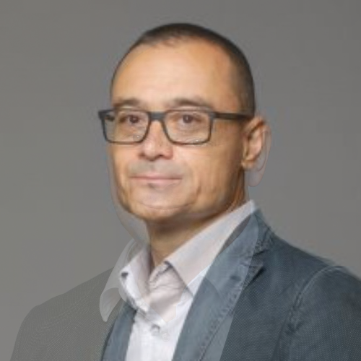
LINEAR MORPHING
α = 0.3
α = 0.5
α = 0.8

Slide 6
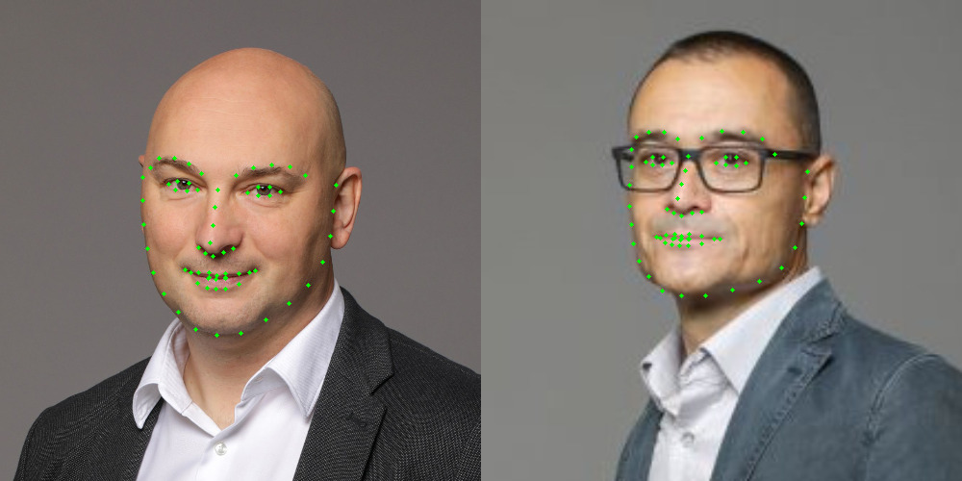
Second method
1. LANDMARKS

Slide 7
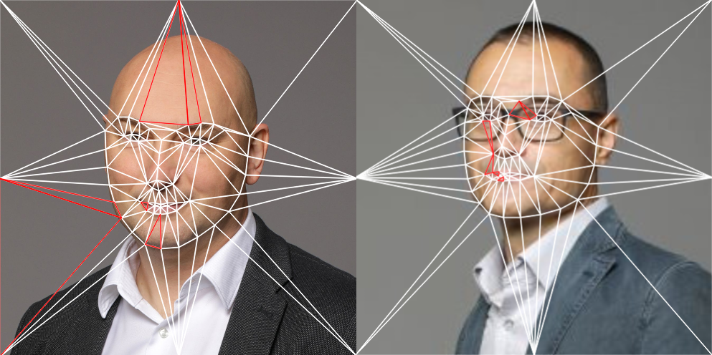
2. Delaunay triangulation

Slide 8
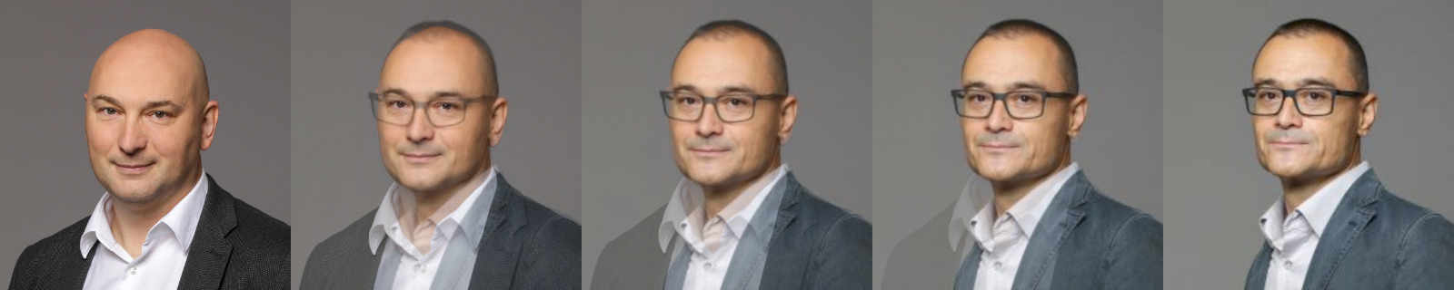
3. MORPHING
1. example

Slide 9
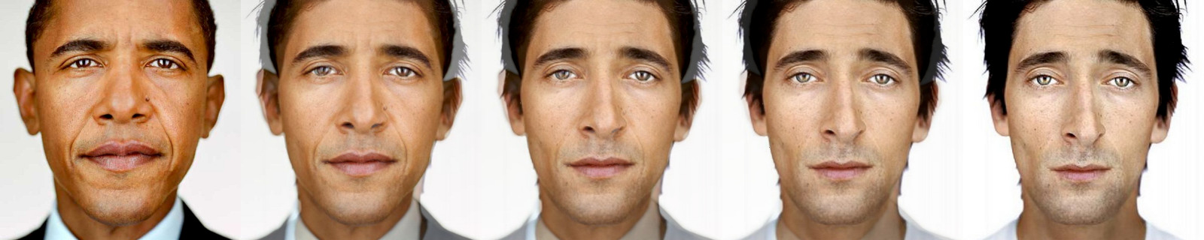
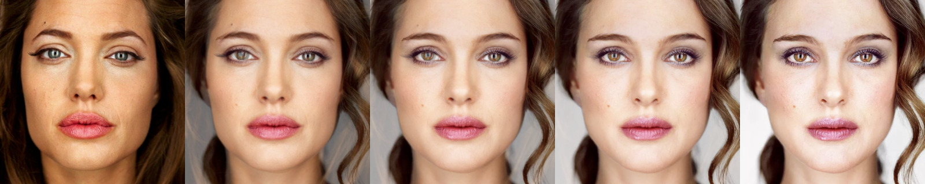
2. And 3. example

Slide 10
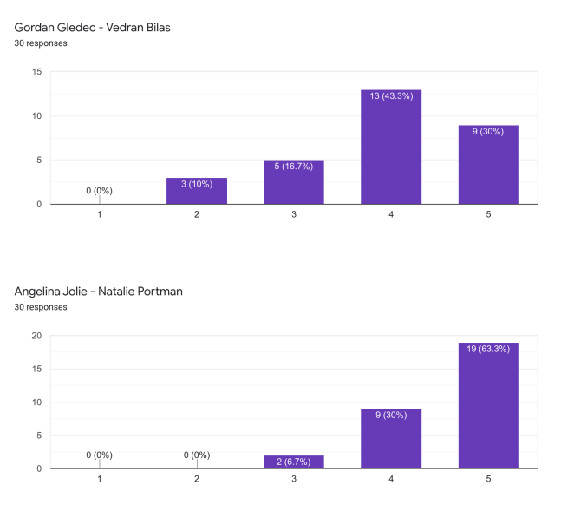
Quality of results
Reviewed by FER students

Slide 11
THANK YOU FOR your attention!

